Slide 1
Insurance Cost Predictions using AI
By: Kevin Abraham & Pranjal Thakkar

Slide 2
Problem Statement
A health insurance provider can only be profitable if the premiums it collects exceed the amount it pays for the beneficiaries' medical care. However, even though some ailments are more common among particular populations, it is difficult to forecast how much a patient's medical expenses will be because the majority of the money comes from their unique conditions.
These unique conditions make it difficult for the health insurance provider to determine the premiums that would help them not only cover the beneficiaries’ medical care but also make a profit.

Slide 3
01
The aim of this project is to forecast insurance premium costs with accuracy using information about individuals, such as age, BMI, smoking status, etc. Furthermore, we will establish what factor has the most impact on insurance rates.
These projections could be used to produce actuarial tables that adjust annual premium prices upwards or downward in accordance with anticipated treatment expenses.
02
Objective of the Project

Slide 4
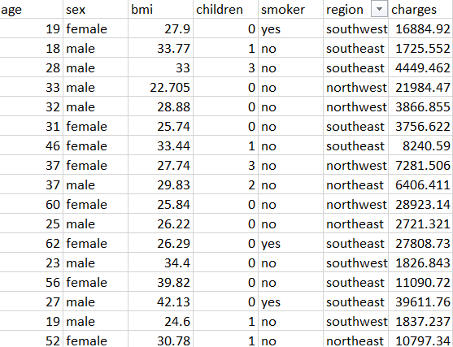
Dataset
The dataset consists of 1339 rows and 7 columns.
Column Name | Description | Data Type
Age | Age of the beneficiary (primary) | Integer
Sex | Gender of the primary beneficiary (male/female) | Boolean
BMI | Body mass index, providing an understanding of the body (weight to height ratio) | Float
Children | the number of children/dependents covered by insurance | Integer
Smoker | Whether the primary beneficiary is a smoker or not. | Boolean
Region | Which region does the beneficiary belong to? i.e., the beneficiary’s residential area. | String
Charges | Individual medical costs billed by the health insurance. | Integer
https://www.kaggle.com/datasets/mirichoi0218/insurance

Slide 5
Predictive Modelling Process
Data Normalization
Optimizing the best Model
Removing null values and scaling the data
Step 2
Step 4
Step 1
Step 3
Step 5
Data Exploration
Deploying predictive models
Analyzing Accuracy Improvement
Analyzing variables and their relationship
Linear Regression, Random Forrest Regressor

Slide 6
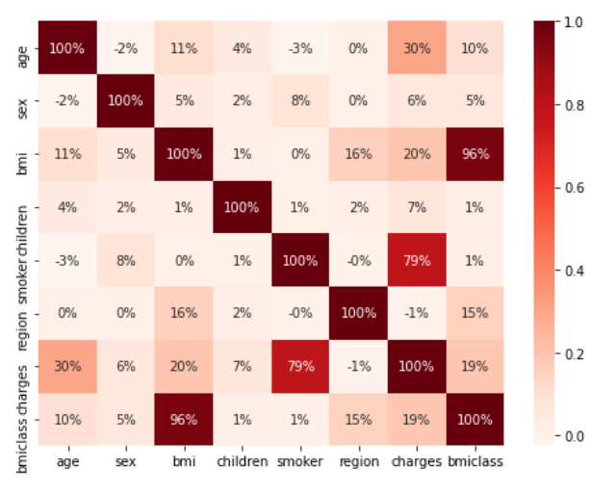
Data Exploration
Correlation
20%
35%
45%
50%
20%
20%
60%
15%
25%
30%
40%
30%
20%
40%

Slide 7
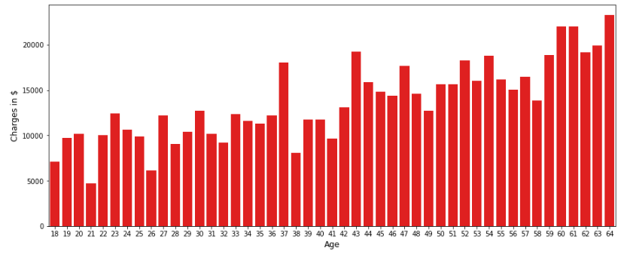

Data Exploration
Visualizing the relationship between Age and Claim Charges ($)
20%
35%
45%
50%
30%
20%
65%
20%
15%
60%
15%
25%
30%
40%
30%
40%
20%
40%
Age
Claim Charges

Slide 8
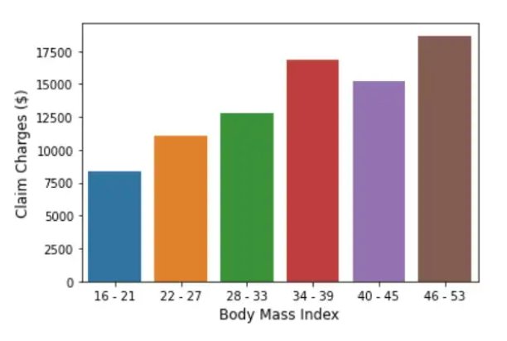
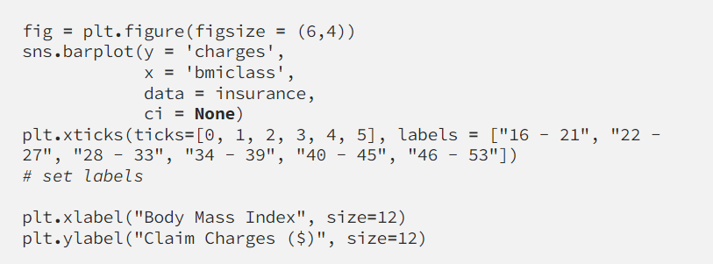
Data Exploration
Visualizing the relationship between BMI and Claim Charges ($)
20%
35%
45%
50%
30%
20%
65%
20%
15%
60%
15%
25%
30%
40%
30%
20%
40%
BMI
Claim Charges

Slide 9
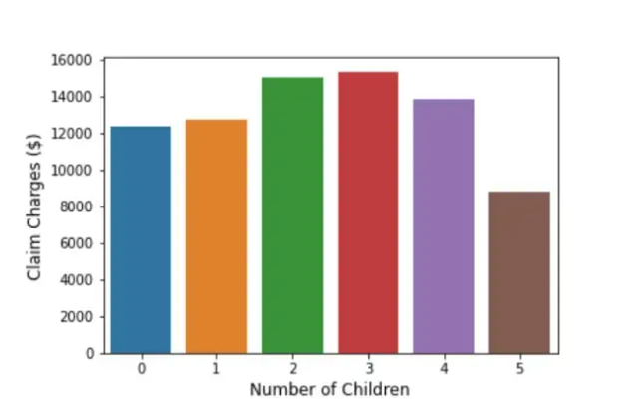
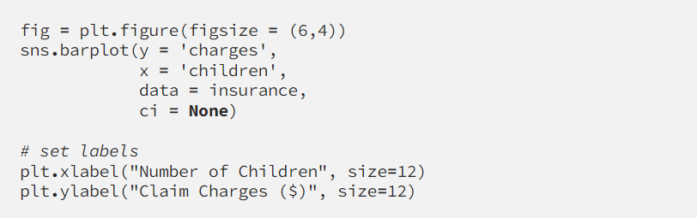
Data Exploration
Visualizing the relationship between Number of Children and Claim Charges ($)
20%
35%
45%
50%
30%
20%
65%
20%
15%
60%
15%
25%
30%
40%
30%
20%
40%
2 or 3 Children
Claim Charges

Slide 10
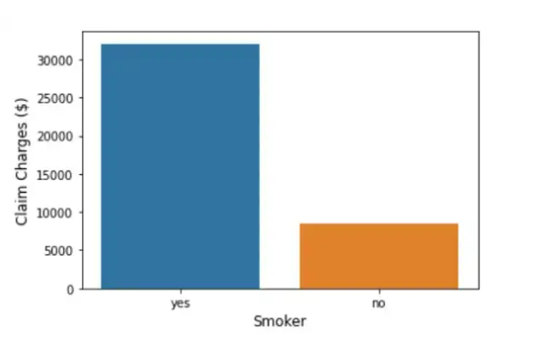
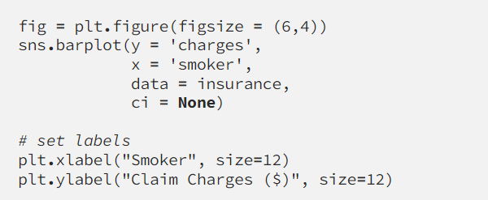
Data Exploration
5. Visualizing the relationship between Smoker and Claim Charges ($)
20%
35%
45%
50%
30%
20%
65%
20%
15%
60%
15%
25%
30%
40%
30%
20%
40%
Smokers
Claim Charges

Slide 11
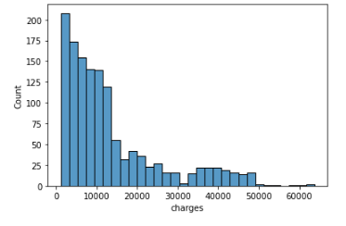

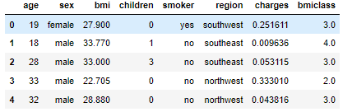
Data Pre-processing
Reason: Since there is skewness in the histogram showed we have to normalize the data.
Using Max and Min Scaler
Output

Slide 12

Data Pre-processing
We need to convert categorical data into numerical data.
What are categorical data
Sex
Smoker
Region

Slide 13
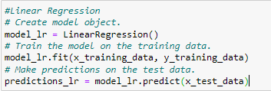

Model 1:
Linear Regression
Why Linear Regression
01
Linear regression uses two or more independent variables to predict the outcome. .
RMSE
02
0.0949123371964687
Comments
03
RMSE shows that linear regression model has a typical prediction error of .09, which is good.

Slide 14
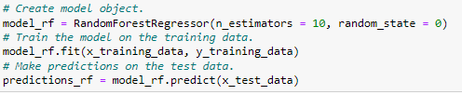

Model 2:
Random Forrest Regression
Why Random Forrest Regression
01
The fundamental idea behind a random forest is to combine many decision trees into a single model.
RMSE
02
0.08248579515212681
Comments
03
RMSE shows that Random Forrest regression model has a typical prediction error of .08, which is good.

Slide 15
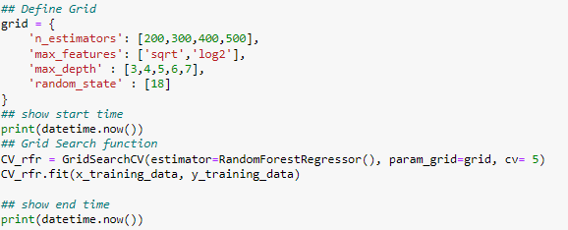
Model Optimization

Slide 16
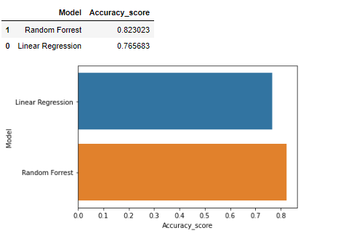
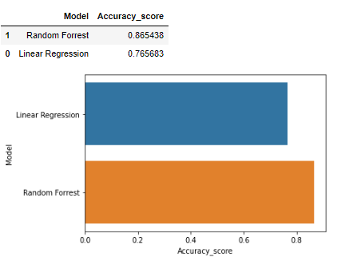
Accuracy Levels
Before Optimization
After Optimization

Slide 17
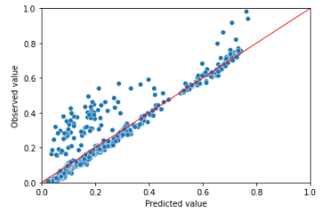
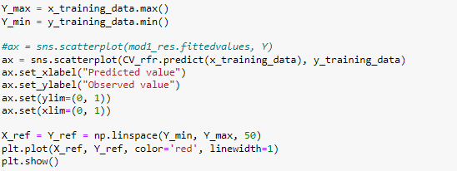
Scatter Plot

Slide 18
Thank You

